Slide 1
Unanswered Prayer

Slide 2
2 Sam 12 v 12 - 23
¹² For you did it secretly, but I will do this thing before all Israel and before the sun.’” ¹³ David said to Nathan, “I have sinned against the Lord.” And Nathan said to David, “The Lord also has put away your sin; you shall not die. ¹⁴ Nevertheless, because by this deed you have utterly scorned the Lord,^{[b]} the child who is born to you shall die.”¹⁵ Then Nathan went to his house. And the Lord afflicted the child that Uriah's wife bore to David, and he became sick. ¹⁶ David therefore sought God on behalf of the child. And David fasted and went in and lay all night on the ground. ¹⁷ And the elders of his house stood beside him, to raise him from the ground, but he would not, nor did he eat food with them.

Slide 3
2 Sam 12 v 12 - 23
¹⁸ On the seventh day the child died. And the servants of David were afraid to tell him that the child was dead, for they said, “Behold, while the child was yet alive, we spoke to him, and he did not listen to us. How then can we say to him the child is dead? He may do himself some harm.” ¹⁹ But when David saw that his servants were whispering together, David understood that the child was dead. And David said to his servants, “Is the child dead?” They said, “He is dead.” ²⁰ Then David arose from the earth and washed and anointed himself and changed his clothes. And he went into the house of the Lord and worshipped. He then went to his own house. And when he asked, they set food before him, and he ate.

Slide 4
2 Sam 12 v 12 - 23
²¹ Then his servants said to him, “What is this thing that you have done? You fasted and wept for the child while he was alive; but when the child died, you arose and ate food.” ²² He said, “While the child was still alive, I fasted and wept, for I said, ‘Who knows whether the Lord will be gracious to me, that the child may live?’ ²³ But now he is dead. Why should I fast? Can I bring him back again? I shall go to him, but he will not return to me.”

Slide 5
Psalm 66 verses 16-20
¹⁶ Come and hear, all you who fear God, and I will tell what he has done for my soul. ¹⁷ I cried to him with my mouth, and high praise was on^{[a]} my tongue.^{[b]} ¹⁸ If I had cherished iniquity in my heart, the Lord would not have listened. ¹⁹ But truly God has listened; he has attended to the voice of my prayer. ²⁰ Blessed be God, because he has not rejected my prayer or removed his steadfast love from me!

Slide 6
1 John 1 v 7-9
7 But if we walk in the light, as he is in the light, we have fellowship with one another, and the blood of Jesus his Son cleanses us from all sin. 8 If we say we have no sin, we deceive ourselves, and the truth is not in us. 9 If we confess our sins, he is faithful and just to forgive us our sins and to cleanse us from all unrighteousness

Slide 7
“For my thoughts are not your thoughts, neither are your ways my ways, declares the Lord.” Isaiah 55:8 ESV
“For as the heavens are higher than the earth, so are my ways higher than your ways and my thoughts than your thoughts.” Isaiah 55:9 ESV

Slide 8
Psalm 103 v 8 - 14
⁸ The Lord is merciful and gracious, slow to anger and abounding in steadfast love. ⁹ He will not always chide, nor will he keep his anger for ever. ¹⁰ He does not deal with us according to our sins, nor repay us according to our iniquities. ¹¹ For as high as the heavens are above the earth, so great is his steadfast love towards those who fear him; ¹² as far as the east is from the west, so far does he remove our transgressions from us. ¹³ As a father shows compassion to his children, so the Lord shows compassion to those who fear him. ¹⁴ For he knows our frame;^{[a]} he remembers that we are dust.

Slide 9
“You have kept count of my tossings; put my tears in your bottle. Are they not in your book?” ‭‭Psalm‬ ‭56‬:‭8‬ ‭ESV‬‬
“You search out my path and my lying down and are acquainted with all my ways.” ‭‭Psalm‬ ‭139‬:‭3‬ ‭ESV‬‬
“I keep your precepts and testimonies, for all my ways are before you.” ‭‭Psalm‬ ‭119‬:‭168‬ ‭ESV‬‬

Slide 10
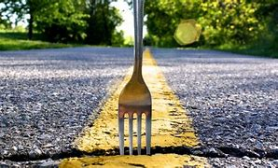

Slide 11
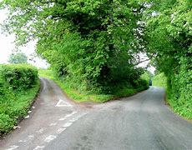

Slide 12
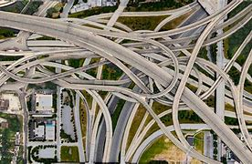

Slide 13
““For his eyes are on the ways of a man, and he sees all his steps.” Job 34:21 ESV
“For a man’s ways are before the eyes of the Lord, and he ponders all his paths.” Proverbs 5:21 ESV

Slide 14
Psalm 37 v 23 - 24
23 The steps of a man are established by the LORD,
when he delights in his way;
24 though he fall, he shall not be cast headlong,
for the LORD upholds his hand.

